Slide 1
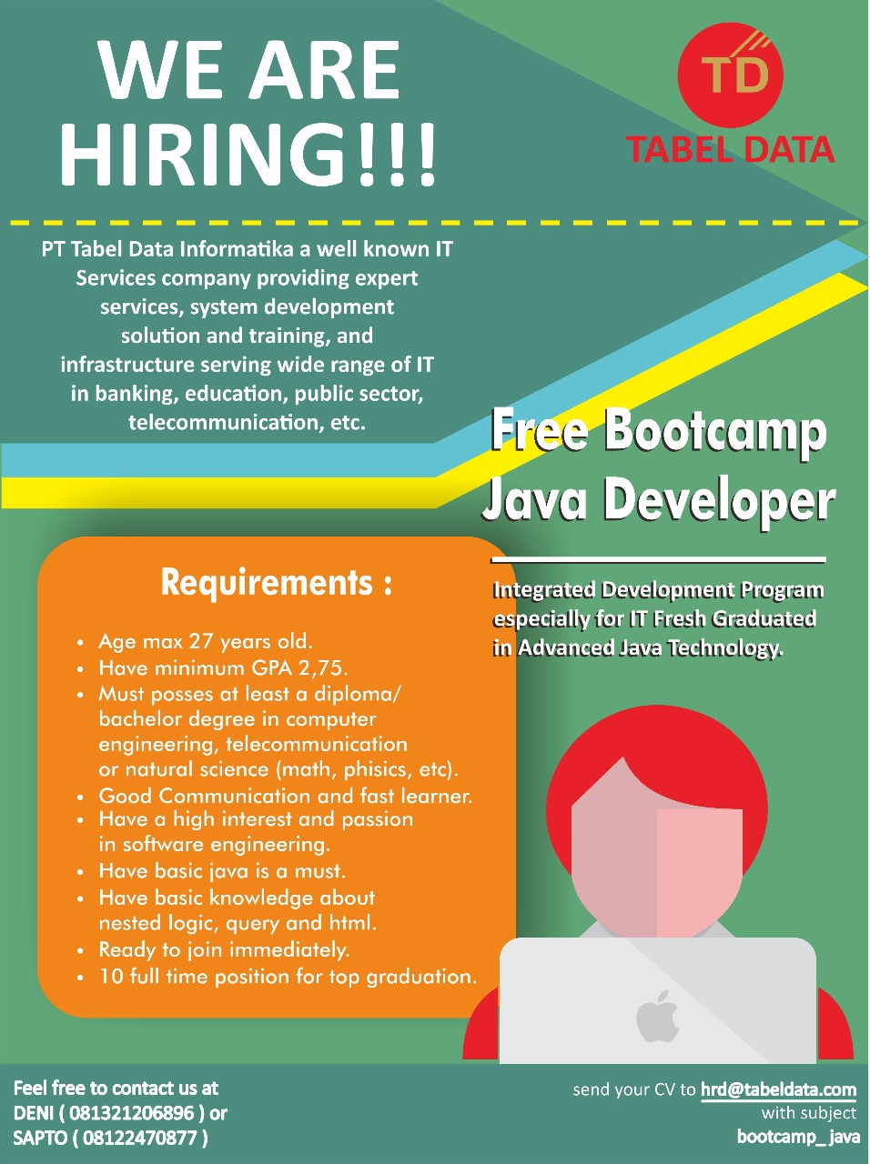
Bootcamp Java Developer #Day 1
PT. Tabel Data Infromatika
By Dimas Maryanto,S.Kom

Slide 2
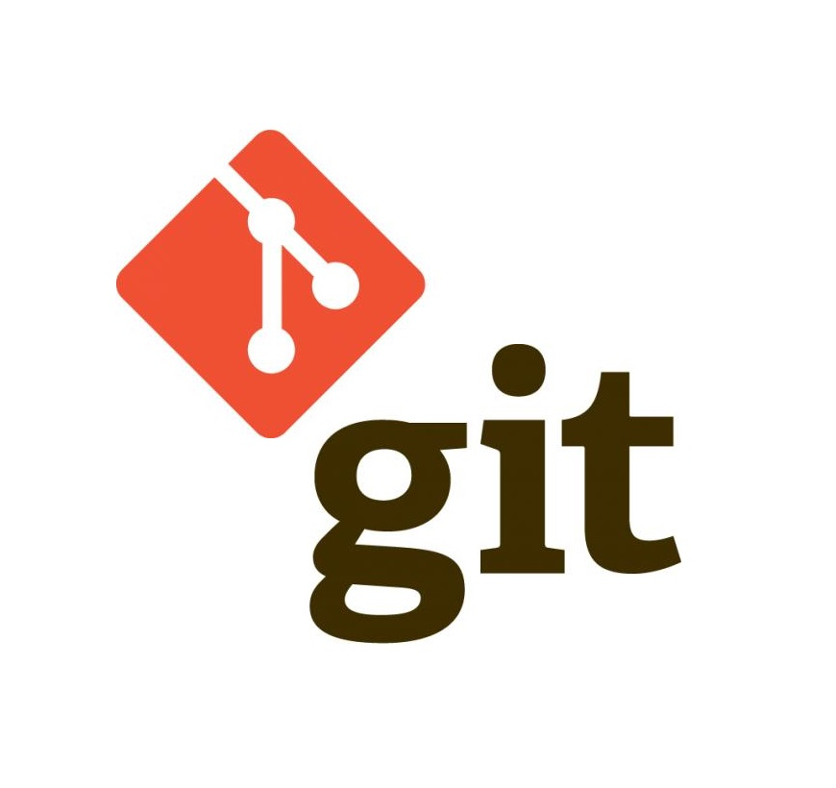
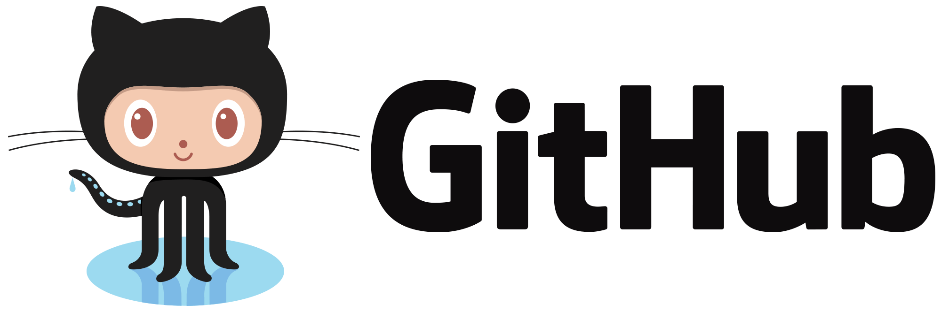


Git Repository & Central Repository

Slide 3
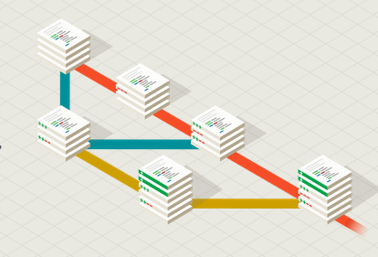
What is Git
Git is a free and open source distributed version control system designed to handle everything from small to very large projects with speed and efficiency.

Slide 4
Istilah - Istilah
Indexing
Add
Commit
Pull
Push
Remote

Slide 5
Kelebihan Apache Maven
Mudah digunakan, Perintahnya mudah diingat
Local dan Remote Repository
Lebih cepat

Slide 6
Membuat project dengan Apache Maven - Archetype
Setup git repo local
Membuat Project Git
untuk pertama kali setup inital commiter
git config --global user.name 'nama-anda'
git config --global user.email 'email-anda'
git init

Slide 7
Praktek
Add
Commit
Pull
Push

